Slide 2
Micro Service using .NET Core 3.0
Viswanatha Swamy

Slide 3
Today’s Topics
Resources in Azure and Source Code
Creating Web API using .NET Core 3.0. Health Check.
Connecting to Azure SQL using EF Core 3.0
Adding Docker Support
Build Docker Image and pushing to Docker Hub
Pulling custom Docker image and executing locally
Creating AKS Cluster
Retrieving the Credentials of AKS
Deploying to Kubernetes and accessing Web API

Slide 4
Disclaimer
Disclaimer:
This exercise is to show “Hello World” of building Micro Service.
Some of the best practices are ignored to complete the exercise on time.
Intention is to cover quite a breath.
There are multiple ways to create Micro Service. This is one of the way.

Slide 5

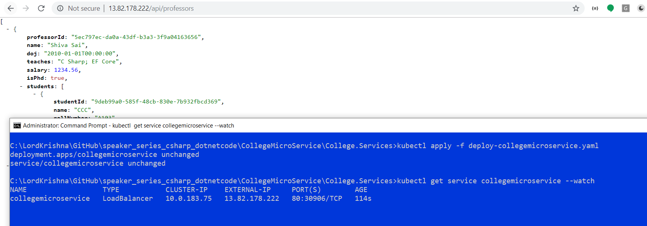
Lighter Moment
Pani Kam Doodh Zada Chai.
Slides Kam Hands-On Zada Session !!!

Slide 6
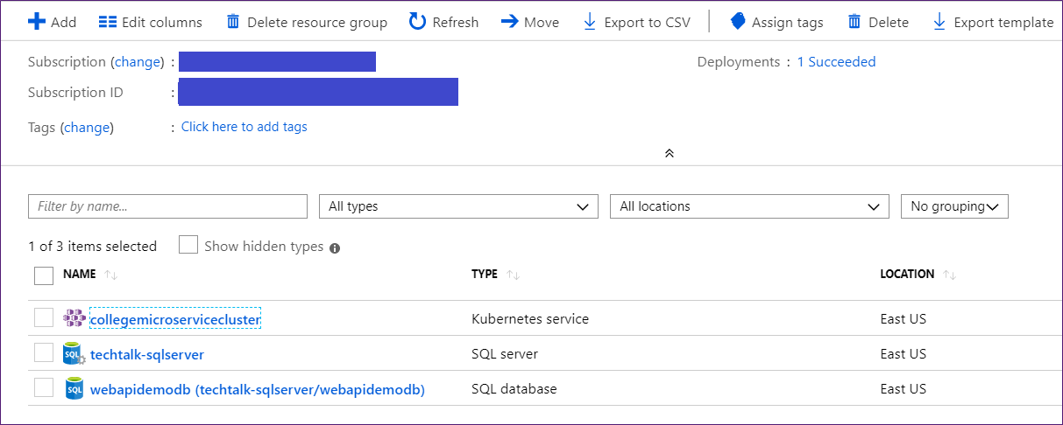
Resources in Azure and Source Code
Azure SQL, Kubernetes Cluster.
Source Code: https://github.com/vishipayyallore/speaker_series_csharp_dotnetcode/tree/master/28Sep2019/College.Services

Slide 7
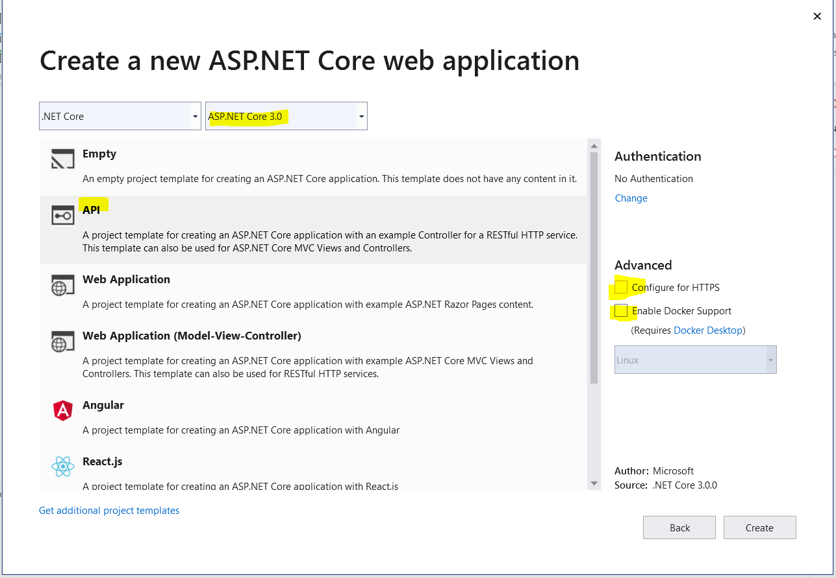
Creating Web API using .NET Core
Tools Used:
Visual Studio 2019
Visual Studio Code [For Kubernetes]
Azure Data Studio [To connect to SQL Azure]
Command line
Kitematic [GUI for Containers]
Step 1:
We will create a new solution and Web API Project.
Execute the Project with IIS Express and Kestrel.

Slide 8
Creating Web API using .NET Core
Demo
>

Slide 9
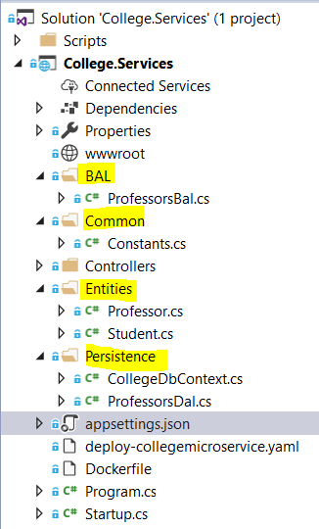
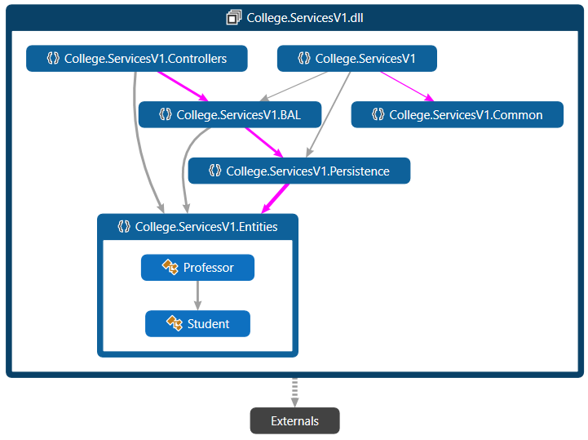
Connecting to Azure SQL using EF Core 3.0
Step 2:
Creating Entities, Persistence, Common, and BAL folders.
Copy the code into those folders; just to save time.
Add the connection string inside appsettings.json
Add the DbContext and application dependencies in startup.cs.
Execute the Values controller, followed by professors controller.
Modify launchSettings.json to execute Professors controller.

Slide 10
Connecting to Azure SQL using EF Core 3.0
Demo
>

Slide 11
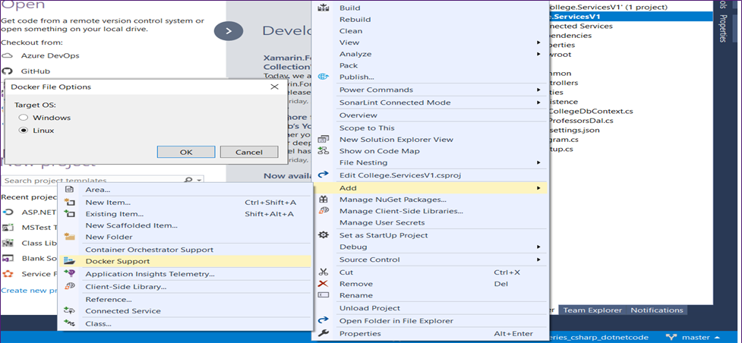
Adding Docker Support
Step 3:
Add Docker support to the project.
Execute the professors controller.

Slide 12
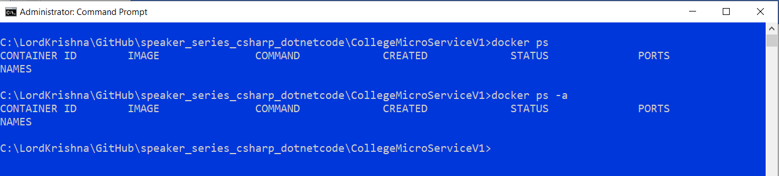
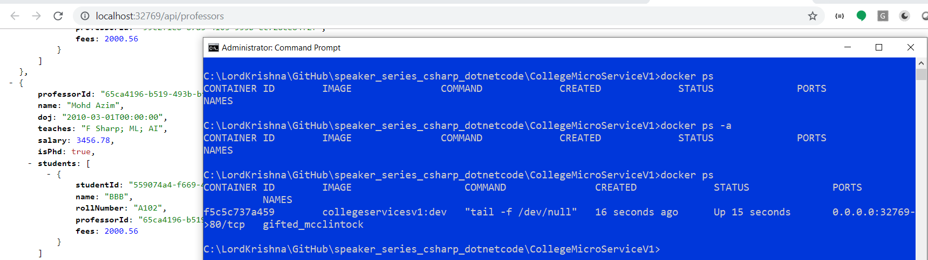
Adding Docker Support

Slide 13
Adding Docker Support
Demo
>

Slide 14
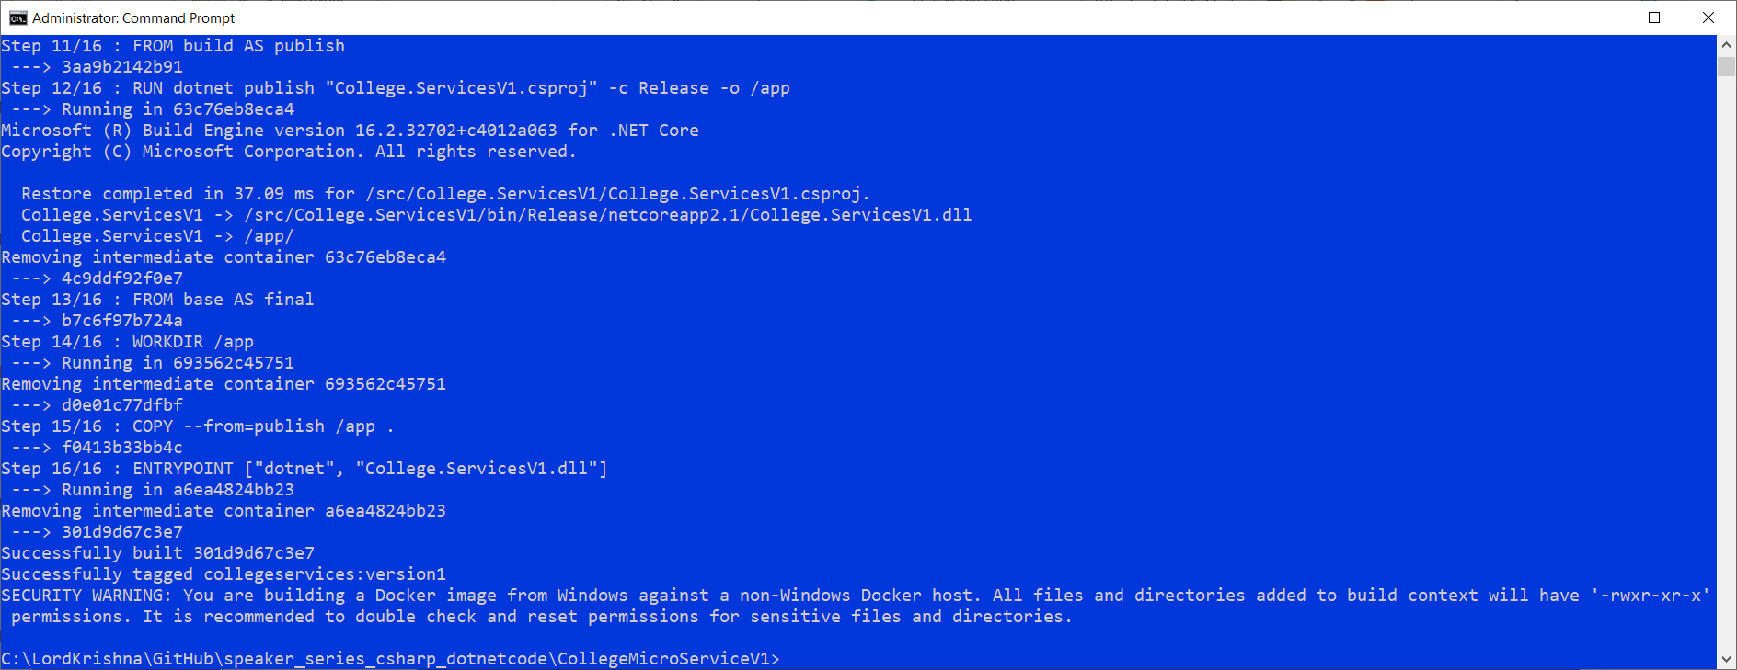
Build Docker Image and pushing to Docker Hub
Step 4:
docker build -f "C:\LordKrishna\GitHub\speaker_series_csharp_dotnetcode\CollegeMicroServiceV1\College.ServicesV1\Dockerfile" -t collegeservices:version1 "C:\LordKrishna\GitHub\speaker_series_csharp_dotnetcode\CollegeMicroServiceV1"

Slide 15
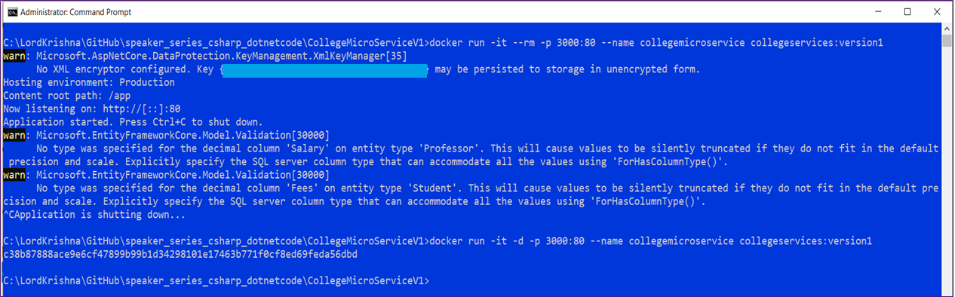
Build Docker Image and pushing to Docker Hub
Step 4:
Live
docker run -it --rm -p 3000:80 --name collegemicroservice collegeservices:version1
Detached
docker run -it -d -p 3010:80 --name collegemicroservice collegeservices:version1

Slide 16
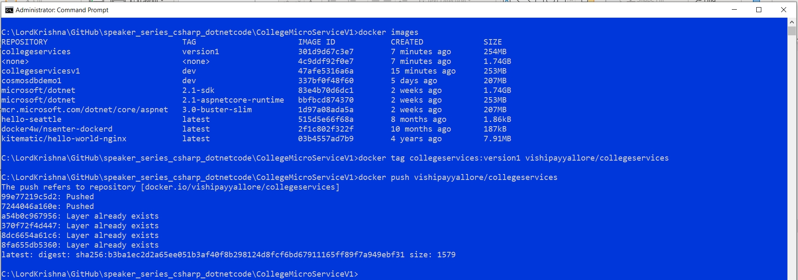
Build Docker Image and pushing to Docker Hub
Step 4:
docker tag collegeservices:version1 vishipayyallore/collegeservices
docker push vishipayyallore/collegeservices

Slide 17
Build Docker Image and pushing to Docker Hub
Demo
>

Slide 18
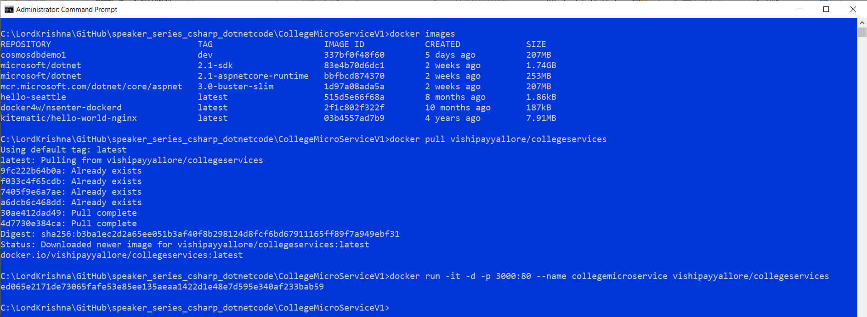
Pulling custom Docker image and executing locally
Step 5:
docker pull vishipayyallore/collegeservices
docker run -it -d -p 3020:80 --name collegemicroservice vishipayyallore/collegeservices

Slide 19
Pulling custom Docker image and executing locally
Demo
>

Slide 20
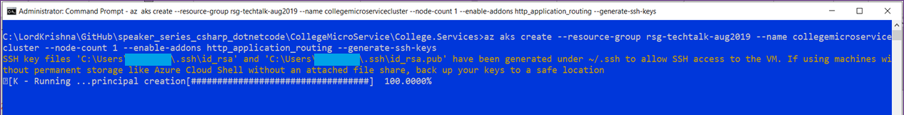
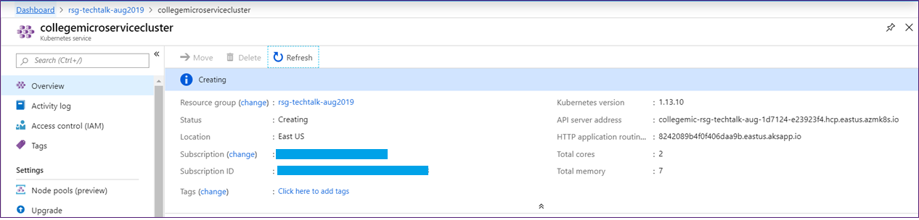
Creating AKS Cluster
Step 6:
az aks create --resource-group rsg-techtalk-aug2019 --name collegemicroservicecluster --node-count 1 --enable-addons http_application_routing --generate-ssh-keys

Slide 21
Creating AKS Cluster
Demo
>

Slide 22
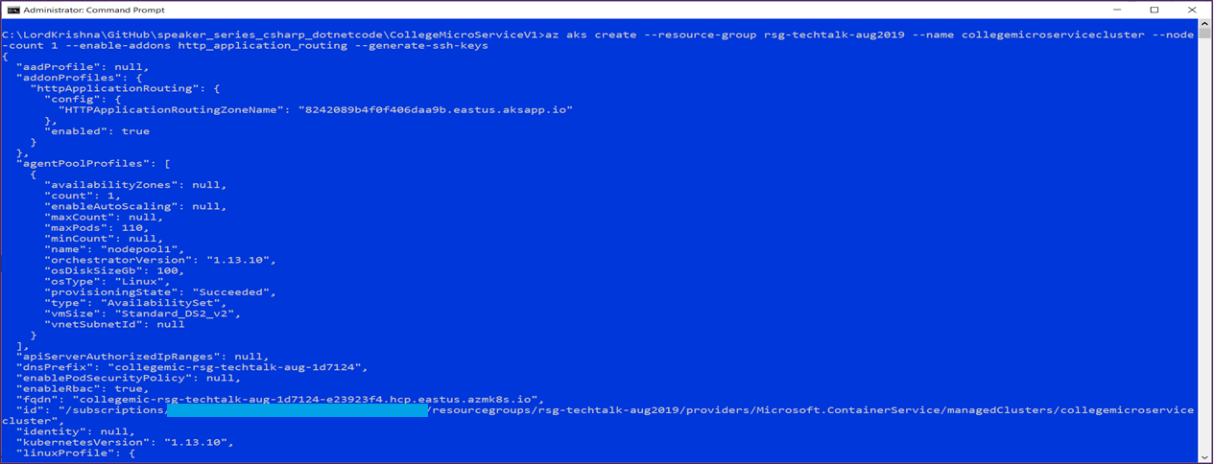
Retrieving the Credentials of AKS
Step 7:
az aks create --resource-group rsg-techtalk-aug2019 --name collegemicroservicecluster --node-count 1 --enable-addons http_application_routing --generate-ssh-keys

Slide 23
Retrieving the Credentials of AKS
Demo
>

Slide 24
Deploying to Kubernetes and accessing Web API
Step 8:
kubectl apply -f deploy-collegemicroservice.yaml
kubectl get service collegemicroservice –watch
kubectl scale --replicas=2 deployment/collegemicroservice

Slide 25
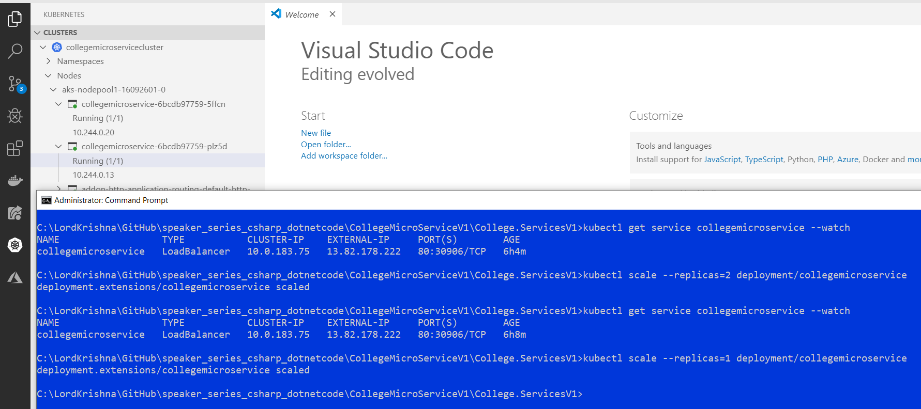
Deploying to Kubernetes and accessing Web API

Slide 26
Deploying to Kubernetes and accessing Web API
Demo
>

Slide 27
Q & A

Slide 28
Thank You

